Slide 1
Convex Fitting Using Tensor Product B-spline
Wai-Shing Luk

Slide 2
Agenda
Introduction
Previous works
Properties of B-spline
Fitting with B-spline curve
References

Slide 3
Introduction
Problem: find a posynomial/convex function that fits a set of data.
Requirements:
  Smoothness, easy to evaluate.
Motivation:
  Geometric Programming (GP): Simulation-based Analog Circuit Sizing

Slide 4
Previous Works
Posynomial fitting (Daems et al., Li et al.)
Sum-of-squares polynomial fitting (Magnani, Lall and Boyd, CDC-ECC’05)
Convex piecewise linear fitting (Magnani and Boyd, Technical Report, 2006)
ConvexFit (Roy and Chen, ICCAD’05)
ConvexSmooth (Roy and Chen, ISQED’06)
SmartSmooth (Roy and Chen, ASPDAC’07)

Slide 5
Posynomial Fitting
Functions are restricted to (generalized) posynomial form.
Useful when need to further build more complicated posynomial functions.
Best fitting in this form is “hard”:
  no convex programming formulation is known.
  No known orthogonal set for posynomial.
If direct integrate to optimization process, solvers only need the function to be convex, direct fitting to a convex function is sufficient.
Notes:
Posynomial fitting has been studied for a while.

Slide 6
SOS Fitting (CDC-ECC’05)
Let S be a set of all polynomials with sum-of-squares (SOS) form.
Fitting data restricted to this form can be formulated as a semi-definite programming (SDP), and hence can be solved optimally.
Difficulties:
  Not optimize among all convex functions.
  Lack of local support (change 1 pt affect all)
  How to determine the number of terms?
  How to select the basis polynomials?
  How to evaluate the function efficiently?

Slide 7
Convex PWL Fitting
Idea: fit the data by max-affine functions f(x) = max{ai^T x + bi}
Least square fitting restricted to this form is not a convex programming; may stuck to local minima.
Not smooth.

Slide 8
ConvexFit (ICCAD’05)
Idea: minimal adjustment of the data set such that its approximated Hessian matrix is convex. This problem can be formulated as an SDP (???).
Then quadratic interpolation is used for smoothing the adjusted data.
Disadvantages:
  Not guarantee that the interpolated points preserves convexity.
  Not guarantee to be smooth.

Slide 9
ConvexSmooth (ISQED’06)
Idea: retain the smoothness and convexity by adding extra interpolated points to the ConvexFit minimization process.
Disadvantage:
  Very slow. Could be 100x slower than ConvexFit.

Slide 10
SmartSmooth (ASPDAC’07)
Not public yet.

Slide 11
B-spline for Convex Fitting
EDA community seems ignore the works in Computer Aided Geometric Design (CAGD), in which the use of B-spline has been studied for decades.
What make B-spline so special in this problem?

Slide 12
Nice Properties of B-spline
Variation diminishing property
Function evaluation is easily obtained by a known recurrence formula (Cox-Boor algorithm).
Derivatives (gradients) are easily obtained.
Local support (only affect the neighbors)
Smooth.
Affine invariant.

Slide 13
Variation Diminishing Property
Loosely speaking: A B-spline curve oscillates no more than its control polygon.
possible
impossible

Slide 14
Least Squares Fit by B-spline
Consider convexity is not required and given that the positions of the knots are fixed.
To find the best fitting is a linear least squares problem and can easily be solved optimally by QR method. (code available in MATLAB’s Spline Toolbox)

Slide 15
LSF by B-spline (Univariate)
Recall that B-spline is a piecewise polynomial.
Minimize sum-of-squares error subject to all second divided differences of control points >= 0.
Recall that
  f[x0,x1,x2] >= 0 ⬄ f[x0,x1] <= f[x1,x2]
  ⬄(f(x1) – f(x0))/(x1 – x0) <= (f(x2) – f(x1))/(x2 – x1)
It is a convex quadratic programming problem with linear inequality constraints, and can optimally be solved.

Slide 16
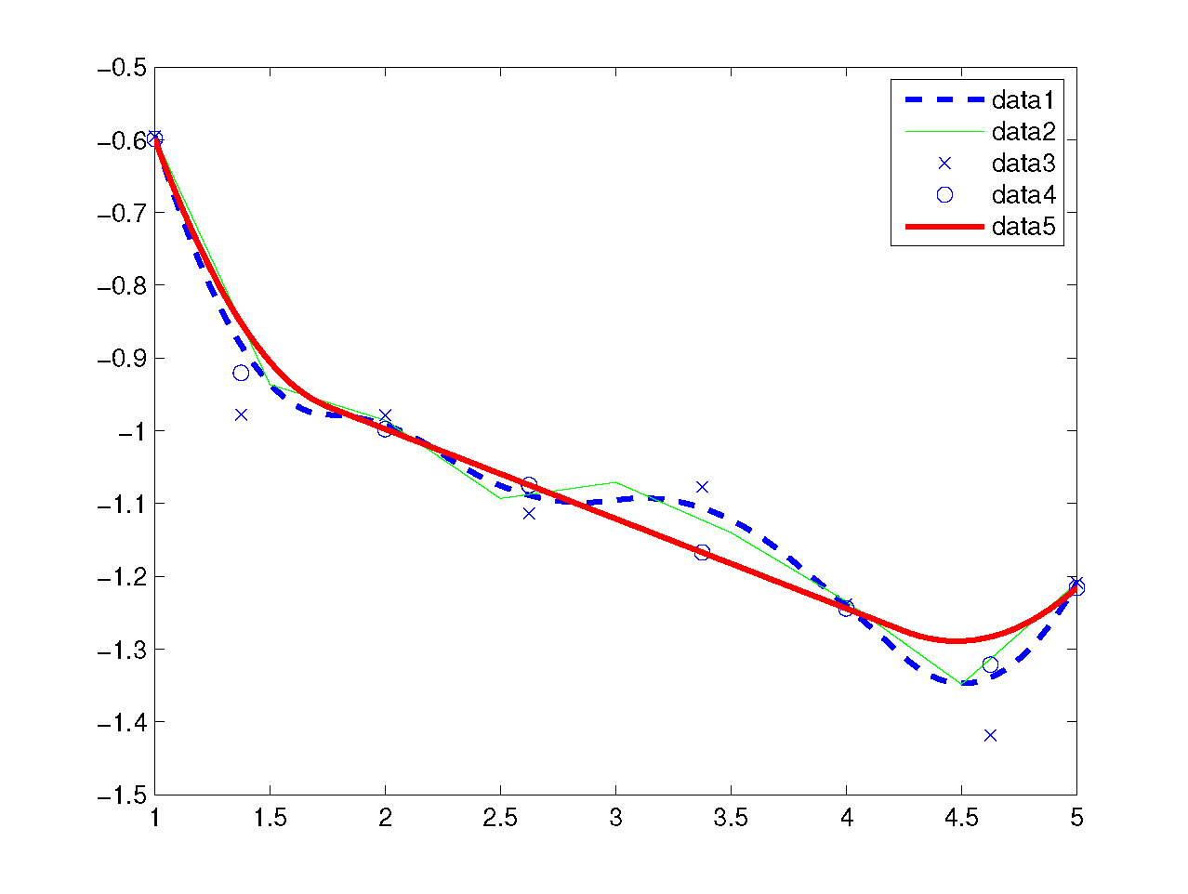
Univariate Case

Slide 17
Multivariate Case
Use tensor product B-spline.
Variation diminishing property still applies???
Linear inequality extends to linear matrix inequality (LMI): nonlinear but still convex. Semi-definite Programming formulation (not implement yet)
Sufficient (but not necessarily) linear constraints: matrix diagonally dominant guarantees semi-definite positive.

Slide 18
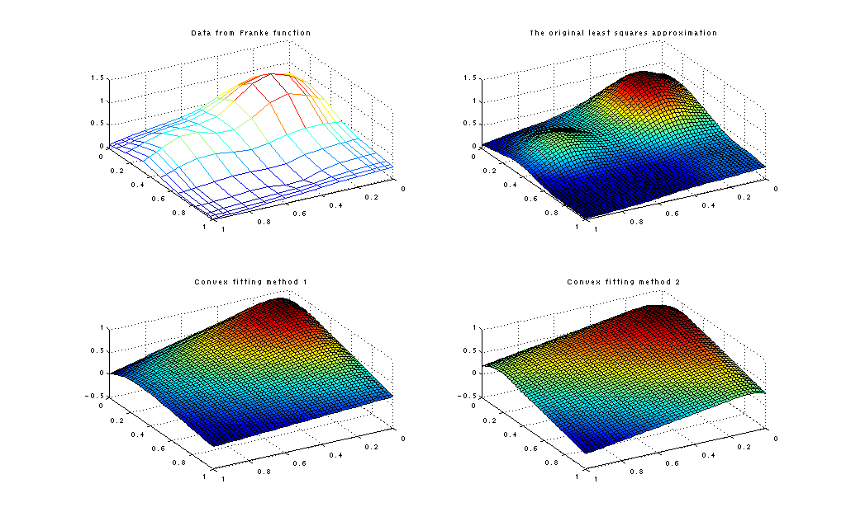
Bivariate Case

Slide 19
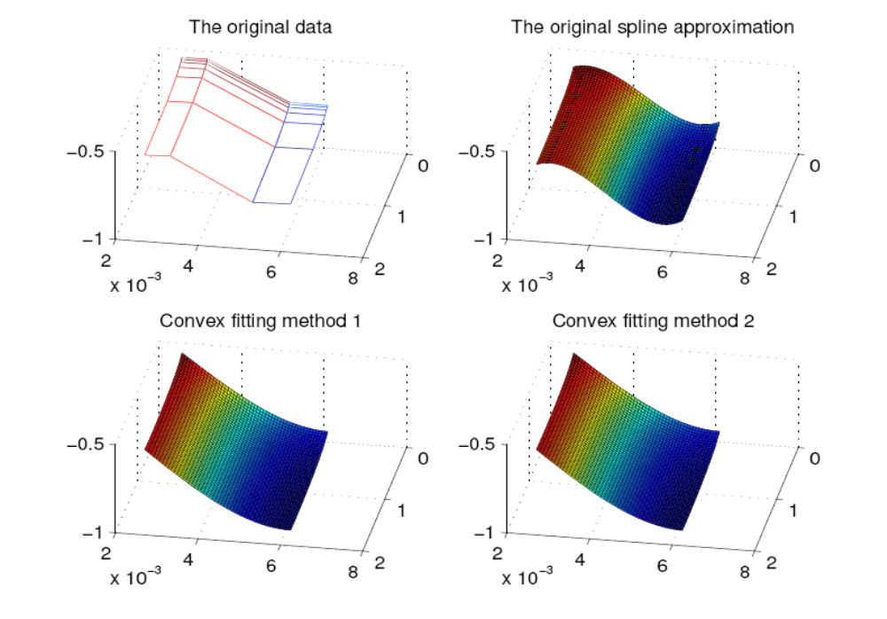
Multivariate Case (n=3)

Slide 20
B-Spline Least Squares Fitting
Without convex restriction, least squares fitting by B-spline already exists in MATLAB’s Spline toolbox.
Questions:
  How to handle process variations? (AA?)
  How to integrate to the existing GP?
  Diffpack how-to
  Semidefinite Programming C++ Package?

Slide 21
Summary
 | CvxPWL | CvxFit | CvxSmth | SOS | B-spline
Convex formulation | ➢ | ➢➢➢➢ | ➢➢➢➢ | ➢➢➢➢➢ | ➢➢➢➢➢
Smoothness | ➢ | ➢➢ | ➢➢➢➢ | ➢➢➢➢➢ | ➢➢➢➢➢
Convex preserve | ➢➢➢➢➢ | ➢➢ | ➢➢➢➢ | ➢➢➢➢➢ | ➢➢➢➢➢
Ease of fitting | ➢ | ➢➢➢➢➢ | ➢ | ➢➢➢ | ➢➢➢➢➢
Ease of evaluation Local support | ➢➢➢➢➢ ➢➢➢➢➢ | ➢➢➢ ➢➢➢➢➢ | ➢➢➢ ➢➢➢➢➢ | ➢ ➢ | ➢➢➢➢➢ ➢➢➢➢➢

Slide 22
Proposal
Apply the new method to our op-amp circuit sizing example.
  E.g. replace one constraint, say phase margin constraint, by Convex fitting, and re-run the ellipsoid method.
Advanced: Implement the method in C++. Replace ACCO optimization engine (differential evolution) with the new method: ellipsoid+cvxfit+evolution
Expert level: robust design: ellipsoid+cvxfit+AA+evolution

Slide 23
References
MATLAB’s Spline toolbox.
“An Interactive Introduction to Splines” at
  http://www.ibiblio.org/e-notes/Splines/Intro.htm
Interpolation and Approximation by Polynomials, Phillips, G.M., Springer, 2003

